Slide 1

Data 1200: Introduction to Data analytics Final Project
SUBMITTED BY:
SHRADDHA SHINDE
STUDENT NO.100881794

Slide 2
Description of Problem
Mr. John Hughes would like to figure out which is the best model to use to predict if a person is likely to suffer from diabetes or not, by using the diabetes dataset.
In this dataset he collected information about 768 people. We want to predict whether a person is at risk of becoming diabetic based on the individual’s data. This information can then be used to begin preventative measures for the individual (example lifestyle change in diet and exercise).
Their attributes will play a vital role to predict if a person is likely to suffer from diabetes or not.
Attributes used: Pregnancies, Glucose, Blood Pressure, Skin Thickness, Insulin, Body Mass Index, Diabetes Pedigree Function, and Age.
In this dataset, we have used following columns as X and Y axis.
X axis : Pregnancies, Glucose, Blood Pressure, Skin Thickness, Insulin, Body Mass Index, Diabetes Pedigree Function, and Age
Y axis : Outcome: No Diabetes = 0, Diabetes=1

Slide 3
Algorithms to be used for analysis
Mr. John Hughes suggested following Machine learning model algorithms, In which the machine learns from the data just like humans learn from their experiences.
Machine learning allows computers to find hidden insights without being explicitly programmed.
These 3 algorithms fall under the Supervised Learning type, used here for classification challenges.
Support Vector Machines
Logistical Regression
Decision Tree

Slide 4
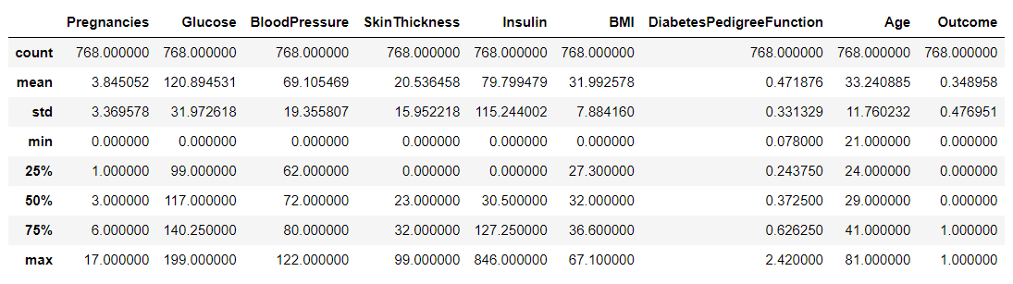
Basic statistic of DataSet
DataFrame.describe() generate descriptive statistics.
Descriptive statistics include those that summarize the central tendency, dispersion, and shape of a dataset’s distribution, excluding NaN values.
Here we are not considering values of Outcome, as it is the dependent attribute.
25%, 50%, and 75% are percentile, meaning how many of the values are less than the given percentile.
For example, 75% percentile of Glucose is 140.25. This means that 75% of people have 140.25 glucose or lower
According to the Dataset, Minimum of Pregnancies, Glucose, BP, Skin thickness, Insulin, BMI is 0. And Min of Diabetes Pedegree Function is 0.078 and Minimum age is 21.
Max no. of pregnancies is 17, max of Glucose is 140.25, Max Blood Pressure is 122, Skin Thickness is 99 and Insulin is 846. Max BMI of the dataset is 67.10 and max age is 81.

Slide 5
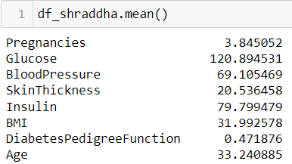
Key Insights- Mean
Mean
The mean is addition of all the data set entities / total number, measure of the center of a data set,
In given dataset, on an average of population were 3 times pregnant
Glucose have highest mean of 120.89.Therefore data says that on an average population have high Glucose.
Most of the population has 69.11 mm Hg blood pressure.
Avg. Triceps skin fold thickness for most of the population is 20.54 mm
Mean of 2-Hour serum insulin is 79.80 mm U/ml means this is the insulin level average of the population has.
Most of the population has Body Mass Index 31.99
A score based on genetic factor of a person (DiabetesPedigreeFunction) on an average is 0.47
All data is of type float

Slide 6
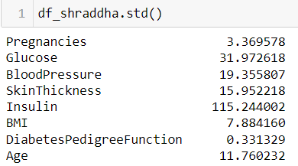
Key Insights- Standard Deviation
Standard Deviation
The Standard Deviation is a measure of how spread-out numbers are around a mean
In given dataset, Std. Deviation is 3.36
Glucose have Std. Deviation 31.97
Population’s blood pressure spread around the mean is 19.35
Triceps skin fold thickness has Std. Deviation is 15.95
Standard Deviation of Insulin is 115.24
Std. Deviation of Body Mass Index is 7.88
A score based on genetic factor of a person
(DiabetesPedigreeFunction) is deviated at 0.33
Standard Deviation of Age is 11.76

Slide 7
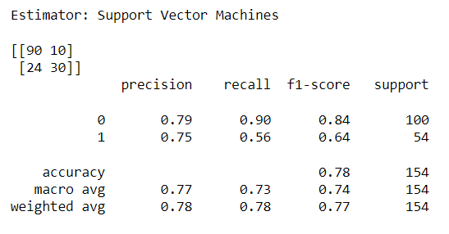
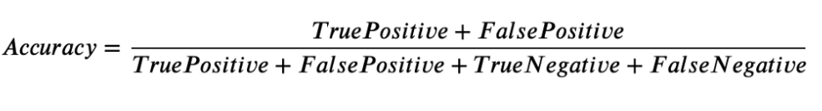
Confusion Matrix of Support Vector Machine
Confusion Matrix
True Positive: 90 positive (diabetic) cases were correctly classified by the model
True Negative: 30 Negative (healthy) cases were correctly classified by the model
False Positive: 10 negative (healthy) cases were incorrectly classified as belonging to the positive class by the model
False Negative: 24 positive (diabetic) cases were incorrectly classified as belonging to the negative class by the model
True Positive: 90 | False Positive: 10
False Negative: 24 | True Negative: 30
Accuracy = 0.78
Support Vector Machine model is saying “I can predict risk of diabetes 78% of the time”

Slide 8
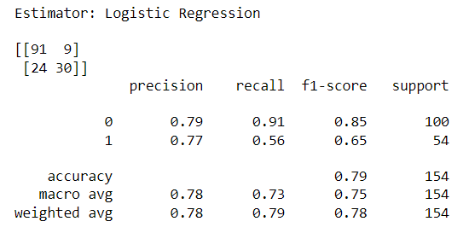
Confusion Matrix of
Logistic Regression
Confusion Matrix
True Positive: 91 positive (diabetic) cases were correctly classified by the model
True Negative: 30 Negative (healthy) cases were correctly classified by the model
False Positive: 9 negative (healthy) cases were incorrectly classified as belonging to the positive class by the model
False Negative: 24 positive (diabetic) cases were incorrectly classified as belonging to the negative class by the model
True Positive: 91 | False Positive: 9
False Negative: 24 | True Negative: 30
Accuracy = 0.79
Logistic Regression model is saying “I can predict risk of diabetes 79% of the time”

Slide 9
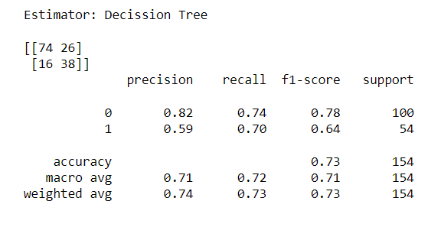
Confusion Matrix of
Decision Tree
Confusion Matrix
True Positive: 74 positive (diabetic) cases were correctly classified by the model
True Negative: 38 Negative (healthy) cases were correctly classified by the model
False Positive: 26 negative (healthy) cases were incorrectly classified as belonging to the positive class by the model
False Negative: 16 positive (diabetic) cases were incorrectly classified as belonging to the negative class by the model
True Positive: 74 | False Positive: 26
False Negative: 16 | True Negative: 38
Accuracy = 0.73
Decision Tree model is saying “I can predict risk of diabetes 73% of the time”

Slide 10
Classification Report of Support Vector Machine
Precision
Recall
F1-score
Precision is the ratio of correctly predicted positive observations to the total predicted positive observations
Class 0- No Diabetes:
79% of the predicted Negative (healthy) cases were correctly predicted by the model
This model is giving 79% accurate results for predicting No Diabetes cases
Class 1- Diabetes:
75% of the Positive (Diabetic) cases were correctly predicted by the model
This model is giving 75% accurate results for predicting Diabetes cases
Recall tells us how many of the actual positive cases we were able to predict correctly with our model.
Class 0 - No Diabetes:
90% of the actual Negative (healthy) cases were successfully predicted by the model
This model is giving 90% accurate results for predicting No Diabetes cases
Class 1- Diabetes:
56% of the actual Positive (Diabetic) cases were successfully predicted by the model
This model is giving 56% accurate results for predicting Diabetes cases
F1-score is a harmonic mean of Precision and Recall. It is maximum when Precision is equal to Recall.
Class 0 - No Diabetes:
F1 Score of Negative (healthy) cases predicted by the model is 0.84
F1 Score tells weighted average of Precision and Recall. As it is ranging between 0.8-0.9, It is a Good Model for predicting No Diabetes cases
Class 1- Diabetes:
F1 Score of actual Positive (Diabetic) cases predicted by the model is 0.64
F1 Score tells weighted average of Precision and Recall. As it is ranging between 0.5-0.8, It is OK Model for predicting Diabetes cases

Slide 11
Classification Report of Logistic Regression
Precision
Recall
F1-score
Precision is the ratio of correctly predicted positive observations to the total predicted positive observations
Class 0- No Diabetes:
79% of the predicted Negative (healthy) cases were correctly predicted by the model
This model is giving 79% accurate results for predicting No Diabetes cases
Class 1- Diabetes:
77% of the Positive (Diabetic) cases were correctly predicted by the model
This model is giving 77% accurate results for predicting Diabetes cases
Recall tells us how many of the actual positive cases we were able to predict correctly with our model.
Class 0 - No Diabetes:
91% of the actual Negative (healthy) cases were successfully predicted by the model
This model is giving 90% accurate results for predicting No Diabetes cases
Class 1- Diabetes:
56% of the actual Positive (Diabetic) cases were successfully predicted by the model
This model is giving 56% accurate results for predicting Diabetes cases
F1-score is a harmonic mean of Precision and Recall. It is maximum when Precision is equal to Recall.
Class 0 - No Diabetes:
F1 Score of Negative (healthy) cases predicted by the model is 0.85
F1 Score tells weighted average of Precision and Recall. As it is ranging between 0.8-0.9, It is a Good Model for predicting No Diabetes cases
Class 1- Diabetes:
F1 Score of actual Positive (Diabetic) cases predicted by the model is 0.65
F1 Score tells weighted average of Precision and Recall. As it is ranging between 0.5-0.8, It is OK Model for predicting Diabetes cases

Slide 12
Classification Report of Decision Tree
Precision
Recall
F1-score
Precision is the ratio of correctly predicted positive observations to the total predicted positive observations
Class 0- No Diabetes:
82% of the predicted Negative (healthy) cases were correctly predicted by the model
This model is giving 82% accurate results for predicting No Diabetes cases
Class 1- Diabetes:
59% of the Positive (Diabetic) cases were correctly predicted by the model
This model is giving 59% accurate results for predicting Diabetes cases
Recall tells us how many of the actual positive cases we were able to predict correctly with our model.
Class 0 - No Diabetes:
74% of the actual Negative (healthy) cases were successfully predicted by the model
This model is giving 74% accurate results for predicting No Diabetes cases
Class 1- Diabetes:
70% of the actual Positive (Diabetic) cases were successfully predicted by the model
This model is giving 70% accurate results for predicting Diabetes cases
F1-score is a harmonic mean of Precision and Recall. It is maximum when Precision is equal to Recall.
Class 0 - No Diabetes:
F1 Score of Negative (healthy) cases predicted by the model is 0.78
F1 Score tells weighted average of Precision and Recall. As it is ranging between 0.5-0.8, It is a OK Model for predicting No Diabetes cases
Class 1- Diabetes:
F1 Score of actual Positive (Diabetic) cases predicted by the model is 0.64
F1 Score tells weighted average of Precision and Recall. As it is ranging between 0.5-0.8, It is OK Model for predicting Diabetes cases

Slide 13
Recommended Model- Logistic Regression Model
We want to predict whether a person is at risk of becoming diabetic based on the individual’s data. This information can then be used to begin preventative measures for the individual (example lifestyle change in diet and exercise)
So, We will focus on the class 1: Diabetes (outcome=1) results of each model using Classification Report
Precision:
Precision is about being precise, i.e, when a model makes a prediction of becoming diabetic, how often it is correct.
In this case it is 59% for Decision Tree and 75% for SVM and 77% for Logistic Regression
Recall:
Recall is the ratio of correctly predicted positive observations to the all observations in actual class. When the model predicts positive, how often is it correct?
In this case it is 70% for Decision Tree, 56% for SVM & Logistic Regression
F1 score:
F1 Score is the weighted average of Precision and Recall.
In our case, F1 score is 64% for Decision Tree, 64% for SVM and 65% for Logistic Regression
Along With this accuracy rate of DT,SVM, and LR are 73%, 78%, and 79% Respectively.
The confusion matrix that Logistic Regression Algorithm produced has slightly more accurate results than Decision Tree and Support Vector Algo., therefore we can conclude that for this problem Logistic Regression algorithm provides more accurate results

Slide 14
Ways to help improve the performance of the Logistic Regression model
Logistic regression is a machine learning algorithm used to predict the probability that an observation belongs to one of two possible classes. A lot of times the accuracy of the model we are building might not be satisfactory. Therefore, we are always looking for better ways to improve the performance of our models.
1. Hyperparameter Tuning - Grid Search
You can improve your accuracy by performing a Grid Search to tune the hyperparameters of your model.
For example, in case of Logistic Regression, the parameter C is a hyperparameter.
Also, you should avoid using the test data during grid search. Instead perform cross validation.
Use your test data only to report the final numbers for your final model.
Please note that Grid Search should be done for all models that you try because then only you will be able to tell what is the best you can get from each model.

Slide 15
Ways to help improve the performance of the Logistic Regression model
2. Data Preprocessing
The greatest improvements are usually achieved with a proper data cleaning process. Logistic regression uses a linear model, so it suffers from the same issues that linear regression does. To properly prepare the data for logistic regression modeling, you need to:
Remove outliers. Outliers will skew your model to perform less well.
Remove multicollinearity. Logistic regression assumes that the predictor variables (features) are not correlated with one another. Check their pairwise correlation and from the analysis, remove those variables which are highly correlated.
Assert linear assumption. If your independent variables do not have a linear relationship with your predictor variable, you need to log transform them to reshape polynomial relationships into linear.
Assert normal distribution. The model assumes that the independent variables follow a Gaussian distribution. Transform your variables with log transform if they are not normally distributed.

Slide 16
References
https://www.analyticsvidhya.com/blog/2020/04/confusion-matrix-machine-learning/
https://www.analyticsvidhya.com/blog/2020/09/precision-recall-machine-learning/
https://www.indeed.com/career-advice/career-development/confusion-matrix

Slide 17

THANK YOU

